Slide 1
How to Remotely Connect to SE70 via TeamViewer
By Joseph Yu

Slide 2
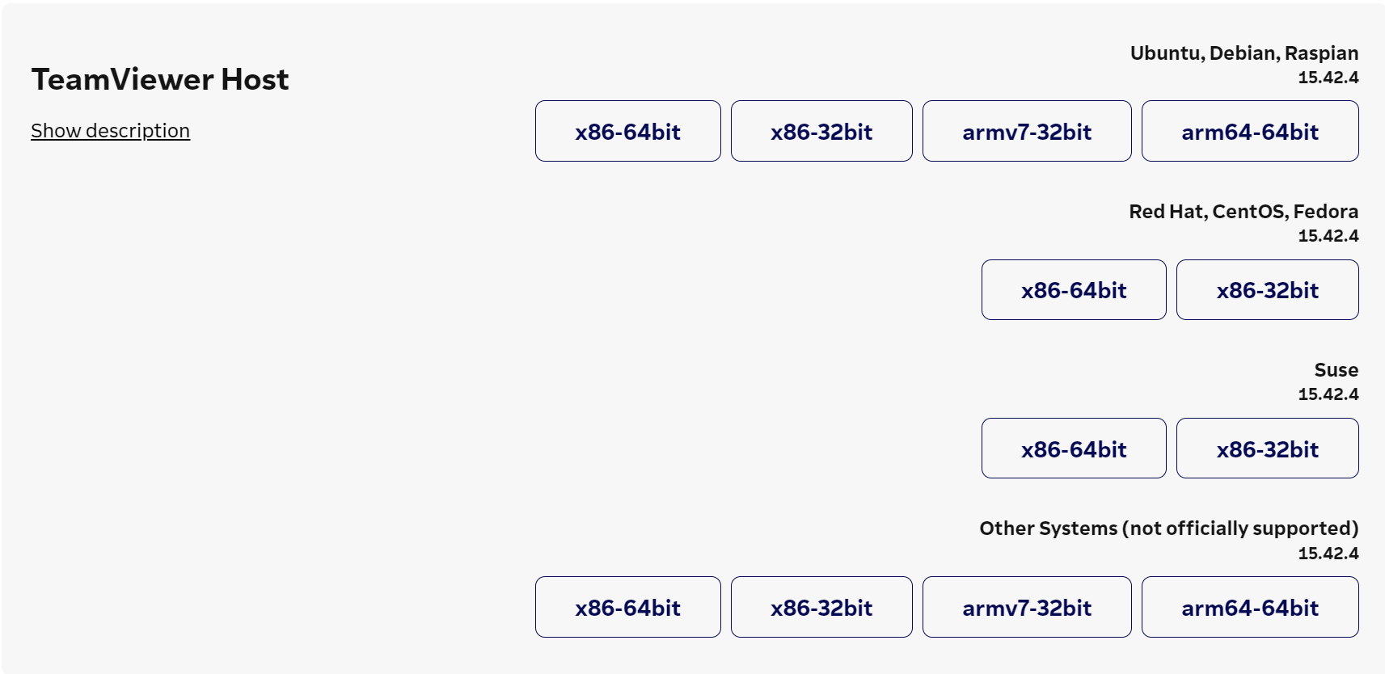
On SE70, install the arm64-64bit version of TeamViewer Host at this link

Slide 3
Install the DEB package
To install the DEB package that was just installed, make sure you’re in your Downloads directory by using:
cd ~/Downloads
Then use this command to use this command to install the DEB package:
sudo apt install ./teamviewer-host_15.x.yyy[arch].deb

Slide 4
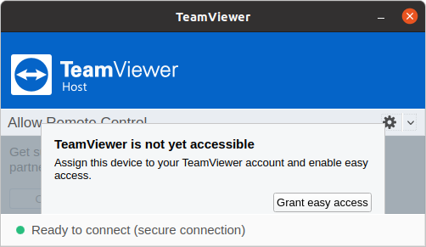
Open Up TeamViewer Host
TeamViewer Host is not ready without a TeamViewer account assigned. Click “Grant easy access”

Slide 5
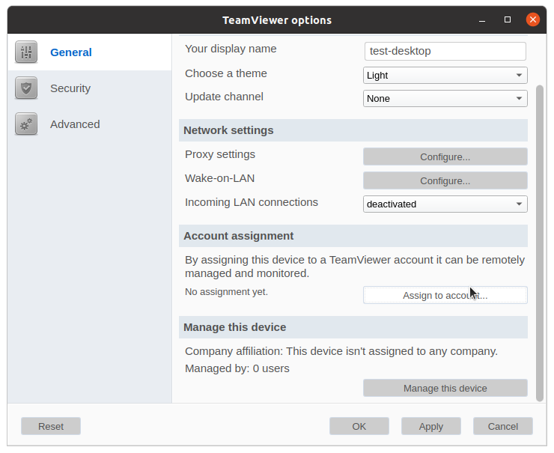
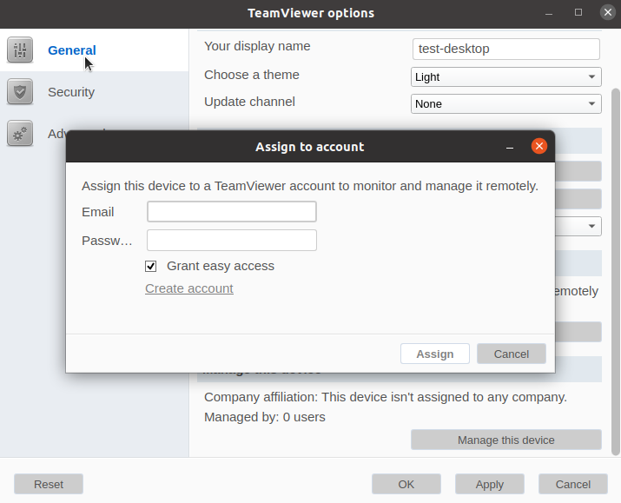
Create a TeamViewer account, then click “Assign to account…” and fill in your account credentials

Slide 6
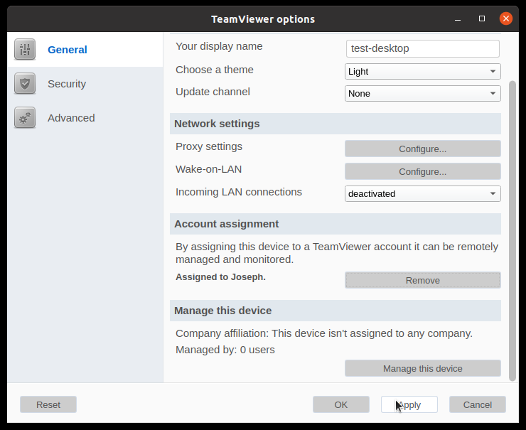
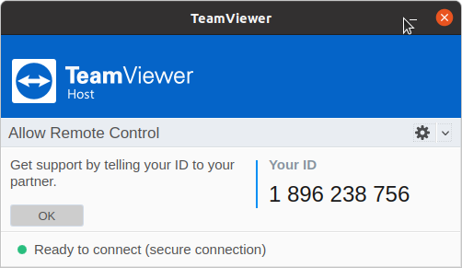
“Apply” the settings changes and take note of the Host ID

Slide 7
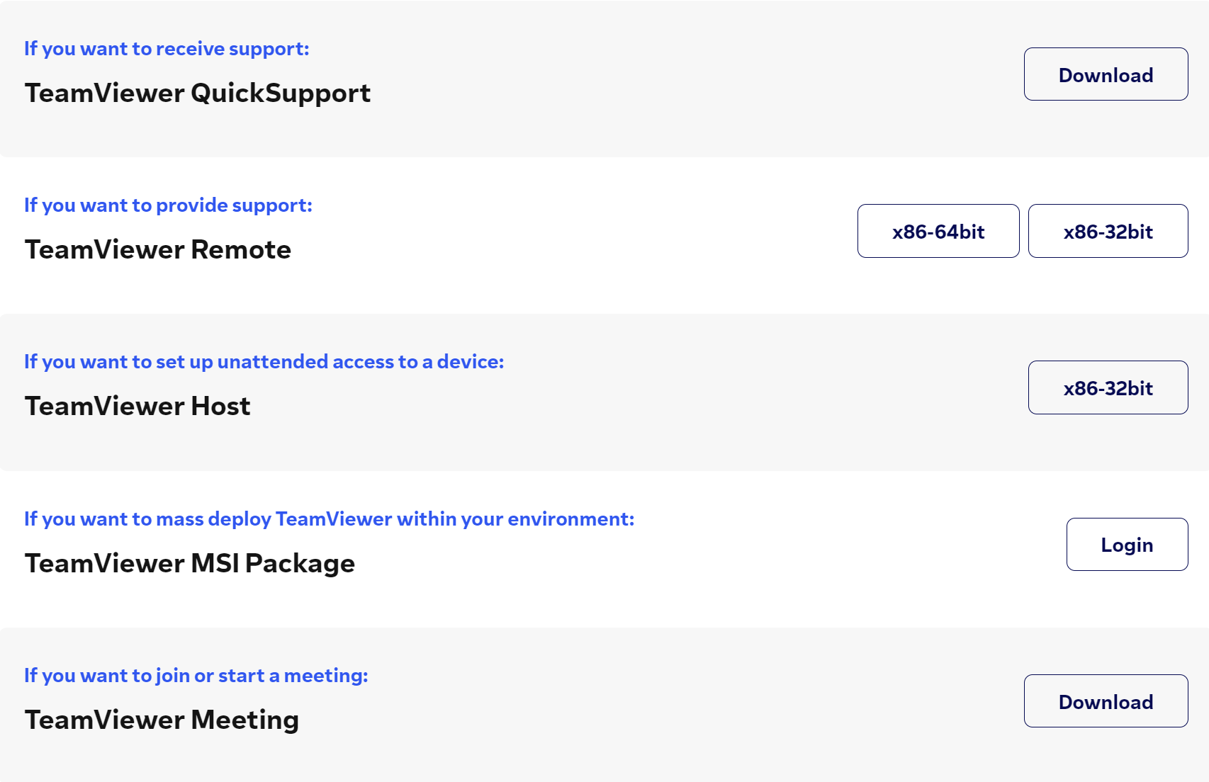
On the Windows device that you want to use as the remote client, visit this link and download TeamViewer Remote then install it.

Slide 8
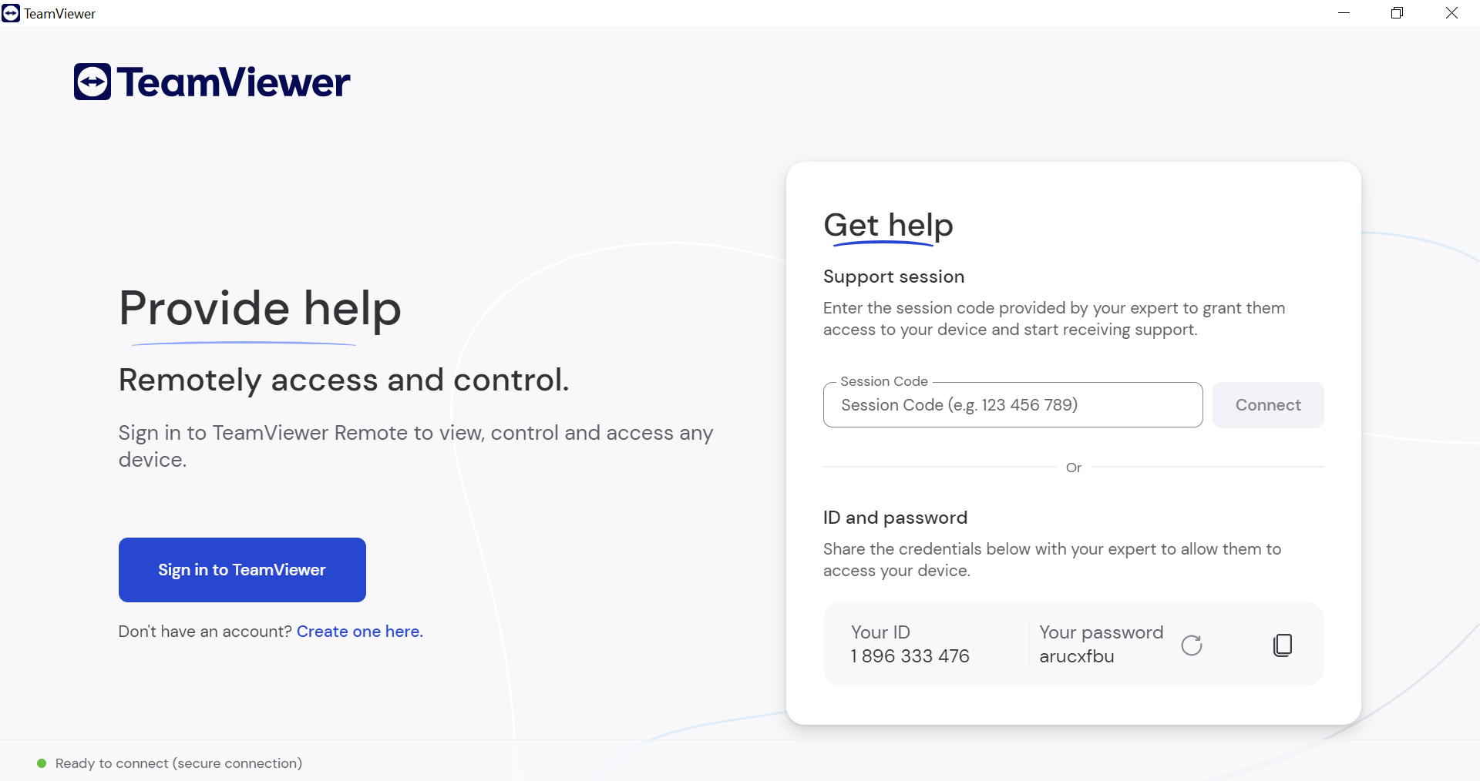
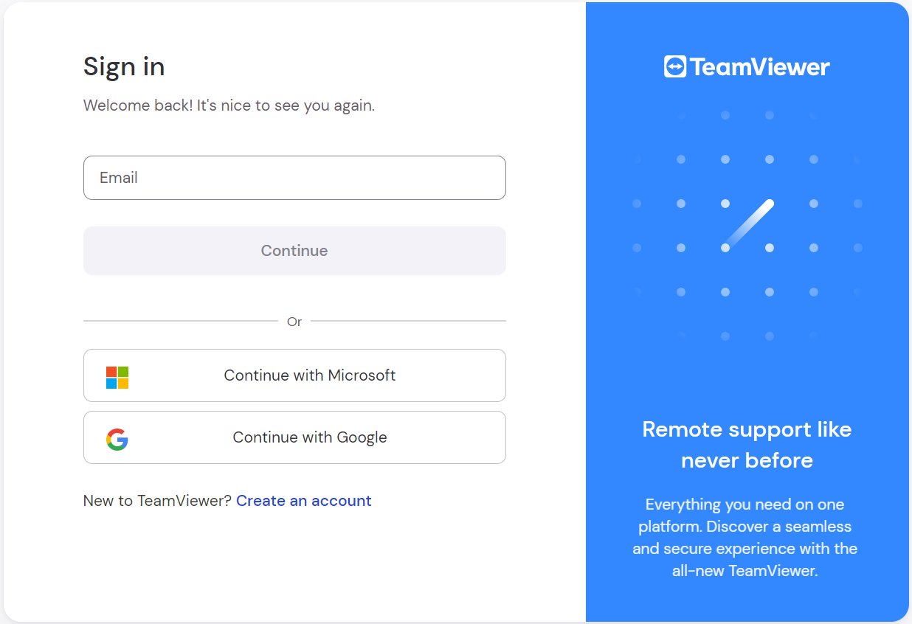
Open up TeamViewer and sign in using your TeamViewer account credentials

Slide 9
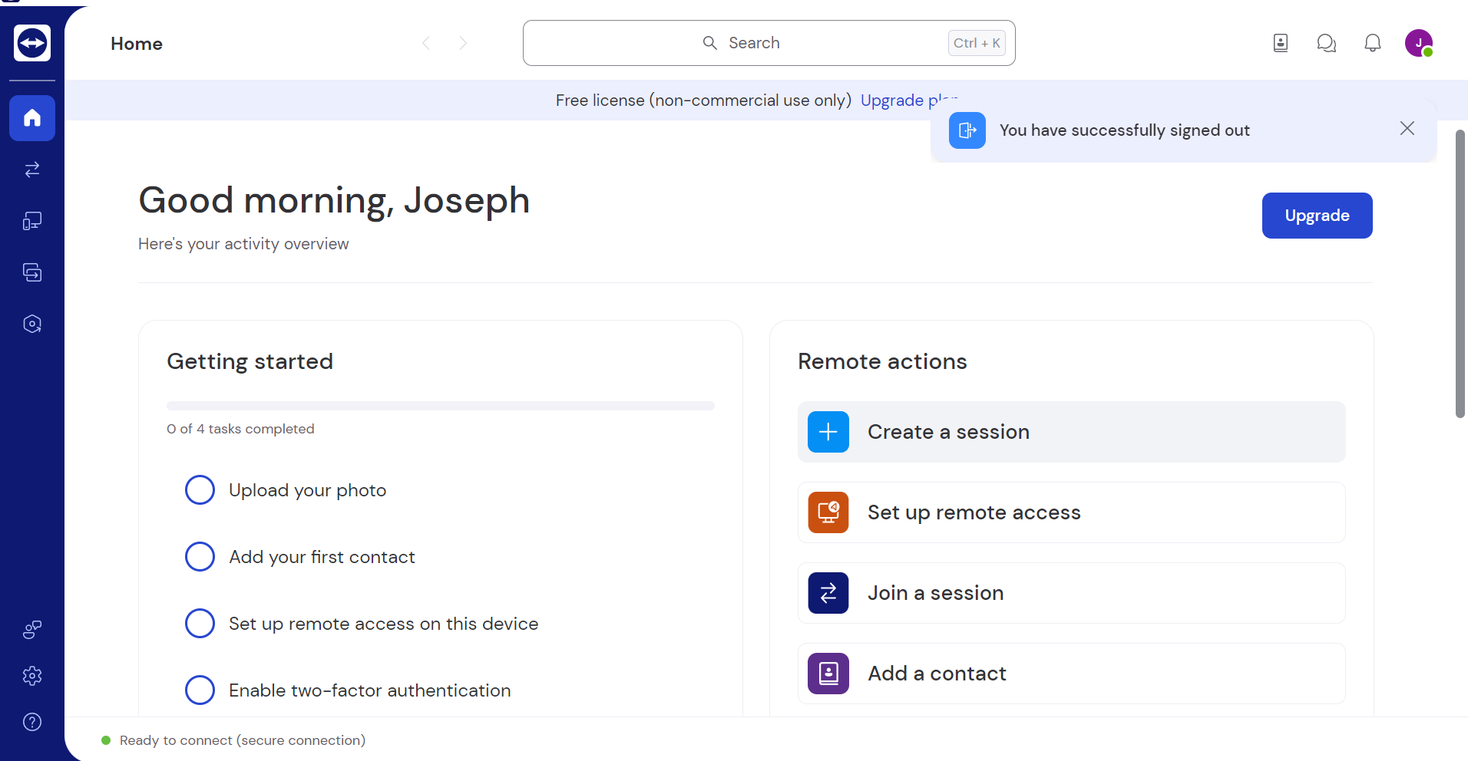

Click “Create a session” and once the prompt on the right shows up, click “Connect to a TeamViewerID”

Slide 10
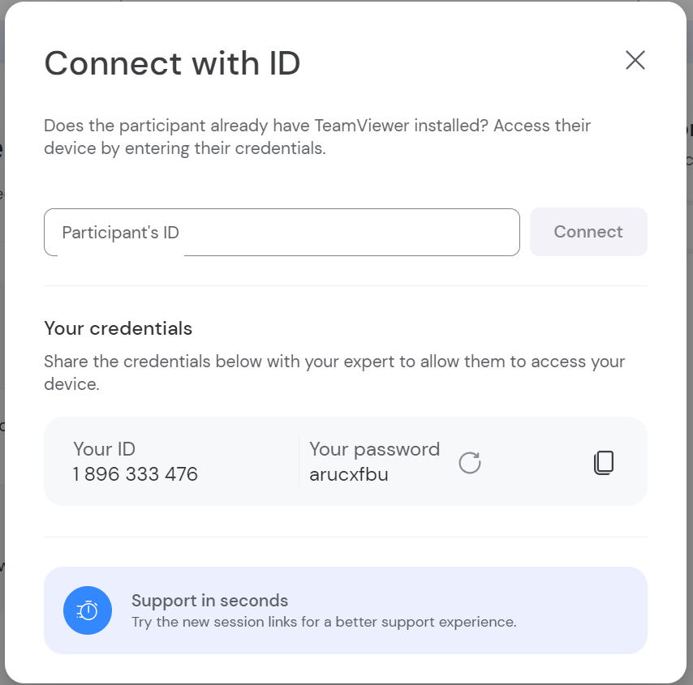
Fill in the “Participant’s ID” with the Host ID from your SE70 and click “Connect”

Slide 11
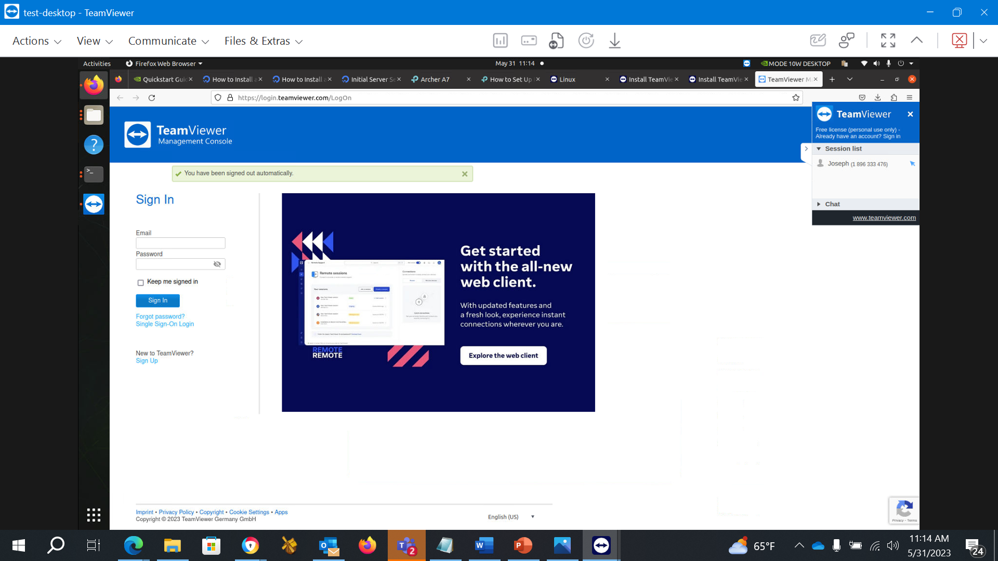
After you click “Connect”, you should get a window pop-up for your new session. Wait a moment for it to fully connect until you get the fully display and control of your SE70.

